Slide 1
Service Mesh in Java microservices with Consul
Wietse Smid
17th of November 2020

Slide 2


About Me
Me
Wietse Smid
32 years old
Work
Senior Consultant @ Capgemini
6 years
Java
Lead Dev
Fun
Cats ====>
Movies/TV Shows
Formula 1

Slide 3
What are we doing today?
Problem Statement
Introduction to Service Meshes
What is Consul?
Demo

Slide 4



Problem Statement Why should you care?
Replication
Scaling up and down
Container environment
Connectivity

Slide 5
Service Meshes How to connect all these microservices?
Service Connectivity
Service Discovery
Security
Load Balancing
Service Mesh
Platform Integration
Health
Checks
Logging

Slide 6

What is Consul?
Automate network configurations, discover services, and enable secure connectivity across any cloud or runtime.
HashiCorp Consul
Service registration and orchestration service
Availability and health
Configuration Management
DNS based service discovery
Dynamic load balancing
Service Mesh

Slide 7



Demo
Containerpilot
Consul Server
Consul Client
Basic Java microservice with health check
Consul Key-Value store
Consul DNS
Basic routing
Load balancing
Unhealthy instances
Consul and Spring Cloud

Slide 8
Demo
Things we are going to solve:
Service Registration and Discovery
Configuration of application variables
Connecting Services
Load Balancing

Slide 9
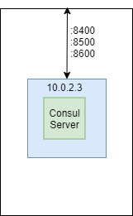
Demo
Containerpilot
Consul Server

Slide 10
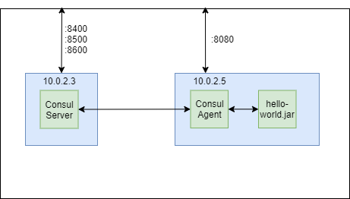
Demo
Consul Client
Basic Java microservice with health check

Slide 11
Demo
Things we are going to solve:
Service Registration and Discovery ✓
Configuration of application variables
Connecting Services
Load Balancing

Slide 12

Demo
Consul Key-Value store

Slide 13
Demo
Things we are going to solve:
Service Registration and Discovery ✓
Configuration of application variables ✓
Connecting Services
Load Balancing

Slide 14
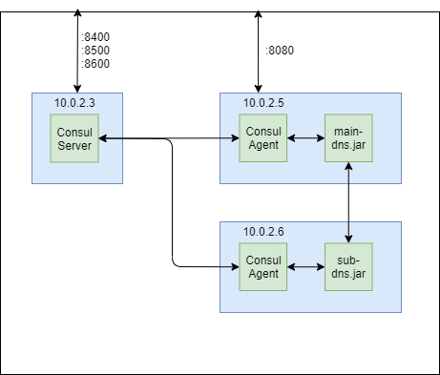
Demo
Consul DNS
Basic routing

Slide 15
Demo
Things we are going to solve:
Service Registration and Discovery ✓
Configuration of application variables ✓
Connecting Services ✓
Load Balancing

Slide 16
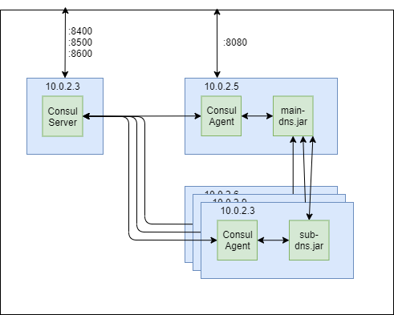
Demo
Consul DNS
Load balancing
Unhealthy instances

Slide 17
Demo
Things we are going to solve:
Service Registration and Discovery ✓
Configuration of application variables ✓
Connecting Services ✓
Load Balancing ✓

Slide 18


Demo
Consul and Spring Cloud

Slide 19
There’s more!
Access Control List (ACL)
Restrict access to consul data an API trough rules and tokens
Consul connect
Service-to-service encrypted connections
Intentions
Restrict access between services based on rules engine

Slide 20
Questions?
Code will available online shortly at:
https://github.com/WietseSmid/bldxxl-consul
Contact me:
wietse.smid@capgemini.com

